Slide 1
Discrete Mathematics BCSC0010
Module 1
Conditional Probability

Slide 2
Conditional Probability
The probability that one event happens given that another event is already known to have happened is called a conditional probability.
Suppose we know that event A has happened. Then the probability that event B happens given that event A has happened is denoted by P(B | A).
Read | as “given that” or “under the condition that”

Slide 3
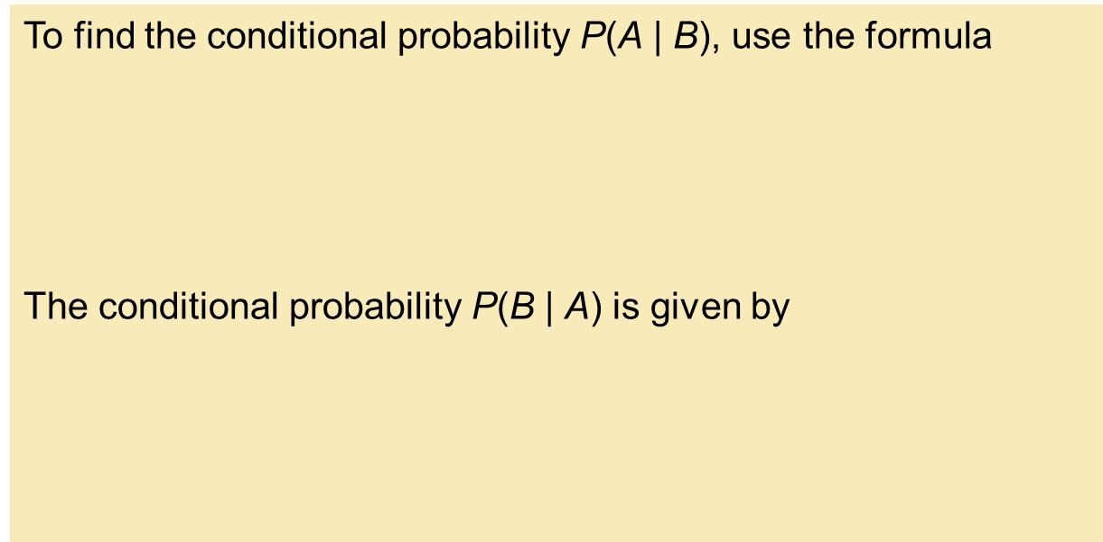
Conditional Probability

Slide 4
Example
A pair of fair dice is tossed. The sample space S consists of the 36 ordered pairs (a, b), where a and b can be any of the integers from 1 to 6. Thus the probability of any point is 1/36 . Find the probability that one of the dice is 2 if the sum is 6.
That is, find P(A|E) where:
E = {sum is 6} and A = {2 appears on at least one die}
E = {(1, 5), (2, 4), (3, 3), (4, 2), (5, 1)} and A ∩ E = {(2, 4), (4, 2)}
Conditional probability, P(A|E) = 2/5

Slide 5
On the other hand ,
A itself consists of 11 elements, that is,
A = {(2, 1), (2, 2), (2, 3), (2, 4), (2, 5), (2, 6), (1, 2), (3, 2), (4, 2), (5, 2), (6, 2)}
Since S consists of 36 elements, P(A) = 11/36.

Slide 6
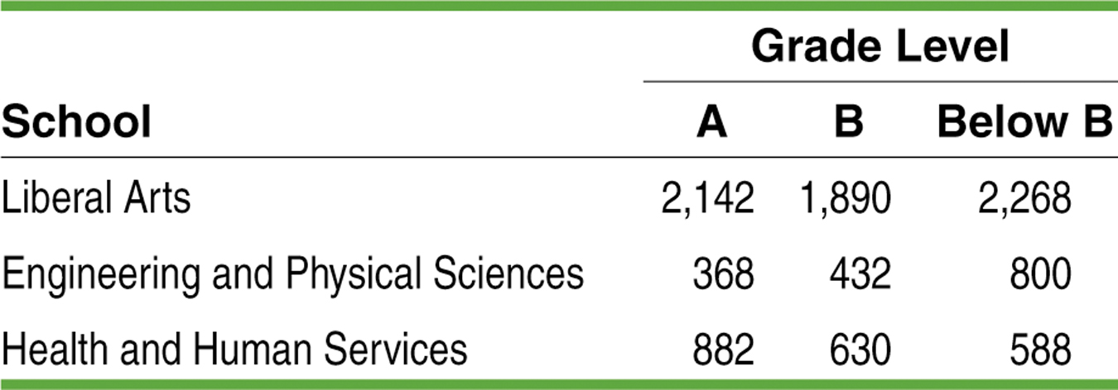
Calculating Conditional Probabilities
E: the grade comes from an EPS course, and
L: the grade is lower than a B.
Total
6300
1600
2100
Total 3392 2952 3656 10000
Find P(L)
Find P(E | L)
Find P(L | E)
P(L) = 3656 / 10000 = 0.3656
P(E | L) = 800 / 3656 = 0.2188
P(L| E) = 800 / 1600 = 0.5000
Notes:
Try Exercise 39

Slide 7
Multiplication Theorem
Case1: If A and B are independent events
P(A ⋂ B)=P(A)*P(B)
Example:
A coin is tossed thrice. Find the chance of getting all heads.
Let events , A=1/2,B=1/2,C=1/2
P(A ⋂ B ⋂ C)=P(A)*P(B)*P(C)
=1/2*1/2*1/2
=1/8

Slide 8
Multiplication Theorem
Case2: If A and B are dependent events
P(A ⋂ B)=P(A)*P(B|A)

Slide 9
Example
A bag contains 5 white and 7 black balls. One ball is drawn each time in succession without replacement. What is the probability of drawing white ball in both draws?
Total number of balls=5+7=12
Probability of white ball in first trial, P(A)=5/12
Probability of white ball in second trial, P(B|A)=4/11
P(A ⋂ B)=5/12*4/11 =20/132

Slide 10
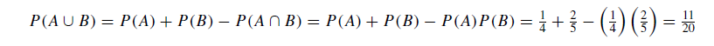
Example
The probability that A hits a target is 1/4, and the probability that B hits the target is 2/5. Both shoot at the target. Find the probability that at least one of them hits the target, i.e., that A or B (or both) hit the target.
We are given that P(A) = 1/2
and P(B) = 2/5 , and we seek P(A∪ B).
Furthermore, the probability that A or B hits the target is not influenced by what the other does; that is, the event that A hits the target is independent of the event that B hits the target, that is, P(A ∩ B) = P(A)P (B). Thus

